Slide 2
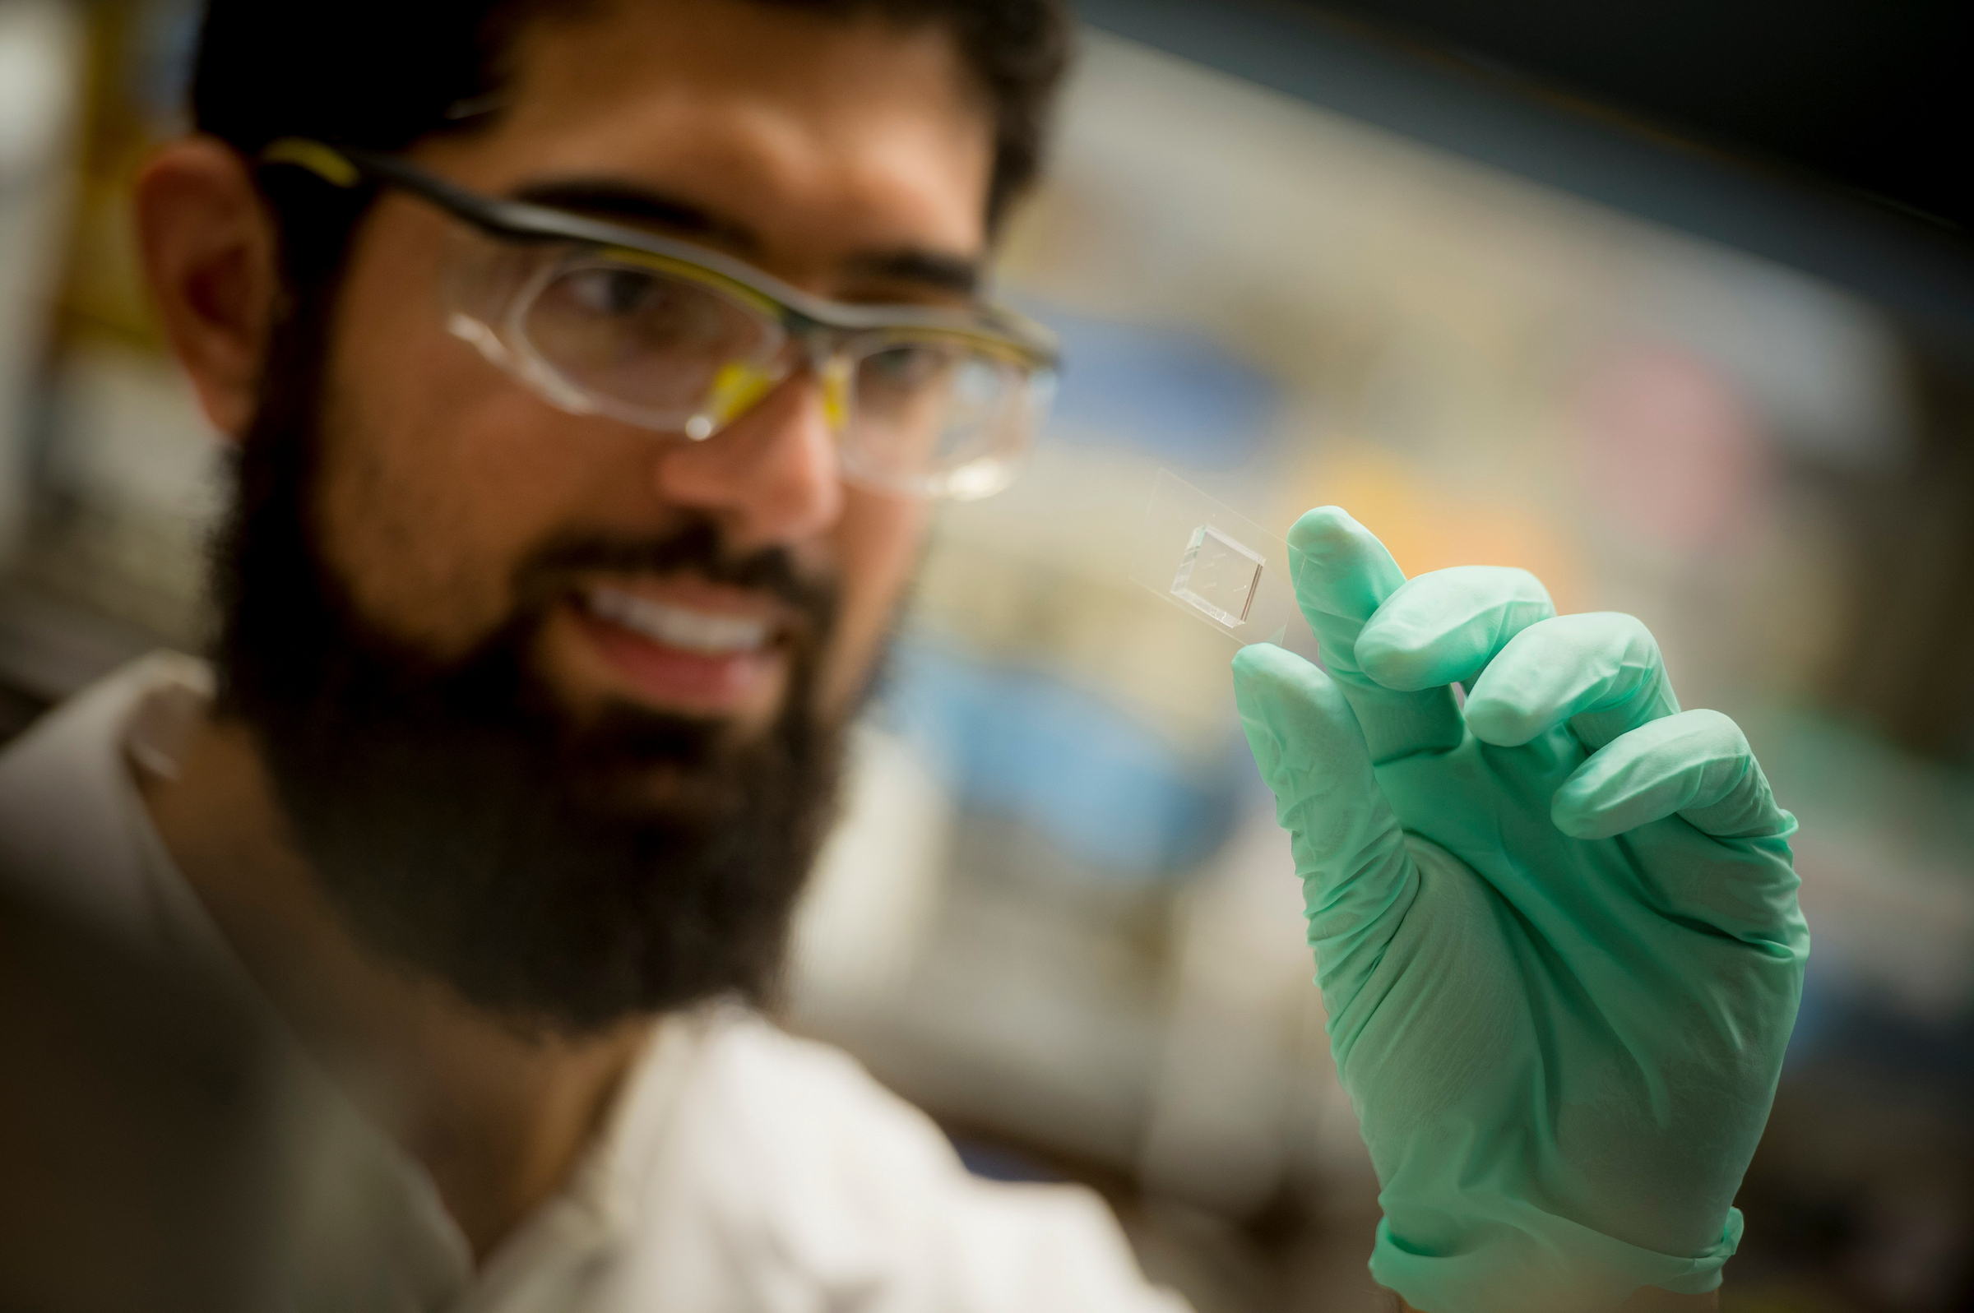

Slide 4
This is the one-column layout slide.
There is room for short sentences or paragraphs, whatever suits your content needs.
You can also link to a website, such as ucsd.edu

Slide 5
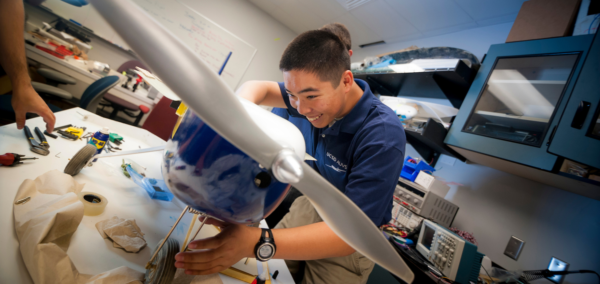
Bulleted text goes here.
Be mindful of the space and avoid overlapping text with other design elements.
You can swap in your own photo to the right.
Sample Image

